Slide 1




How can we model the population dynamics of quantitative traits?
Shikhara

Slide 2
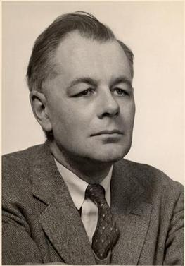
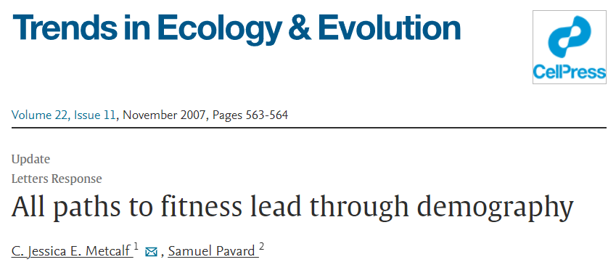


The ecological theatre imposes a need for mechanistic theory
+
–
Evelyn Hutchinson. Picture from Wikipedia

Slide 3


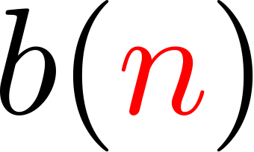
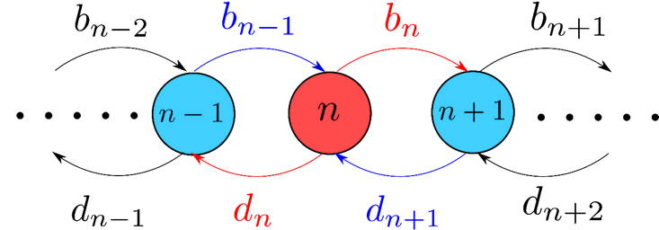

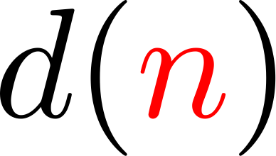

Population dynamics as a stochastic birth-death process
+
–

Slide 4


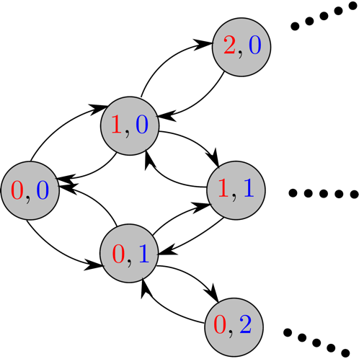
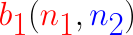


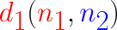
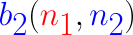


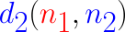
Including more discrete traits is ‘easy’
+
–
+
–

Slide 5

…but what about quantitative traits?

Slide 6
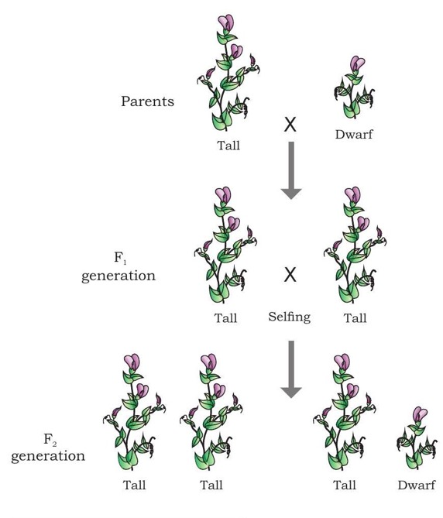
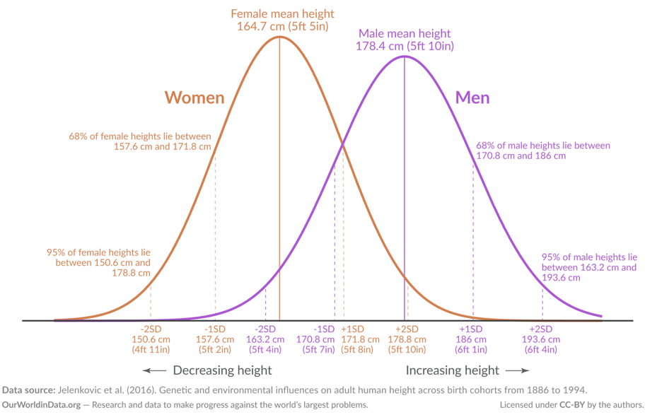
…but what about quantitative traits?

Slide 7
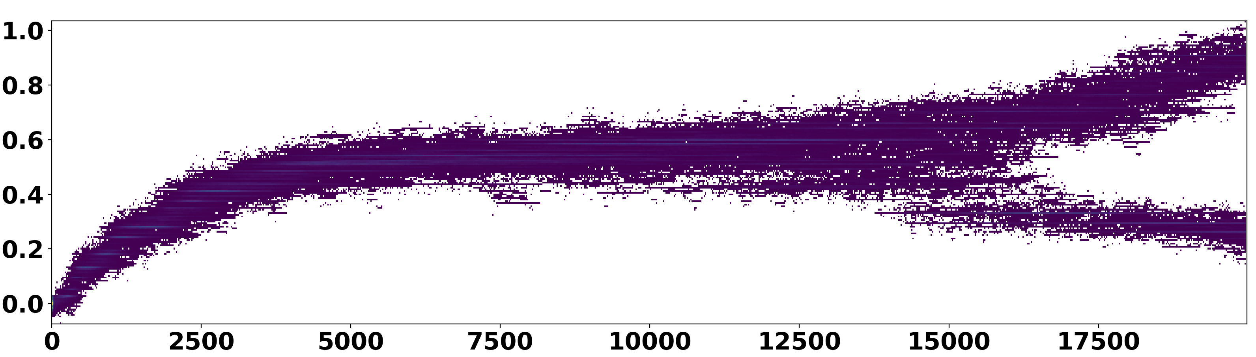
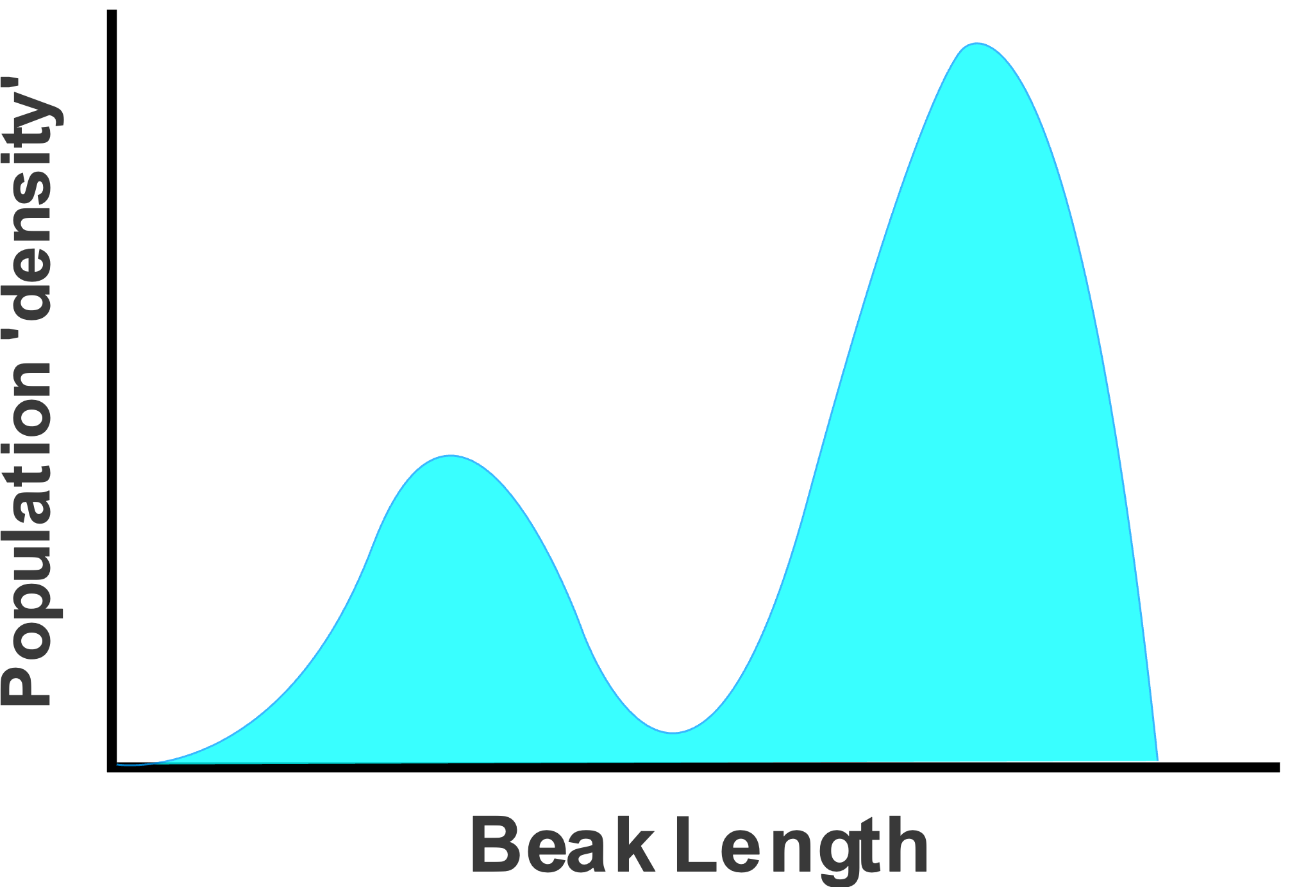
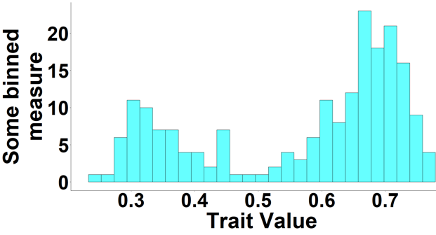
…but what about quantitative traits?
Trait Value
Time
≈
No. of inds
Trait Value

Slide 8
Biological Setting
A finite population of individuals that have traits in some abstract ‘trait space’ 𝒯 (assumed subset of ℝ). Total population size may vary over time.
The trait value of an individual cannot change over its lifetime.
Changes in the population are only through birth and death of single individuals (at a time).
No extrinsic noise --- All noise is due to finiteness of the population.

Slide 9
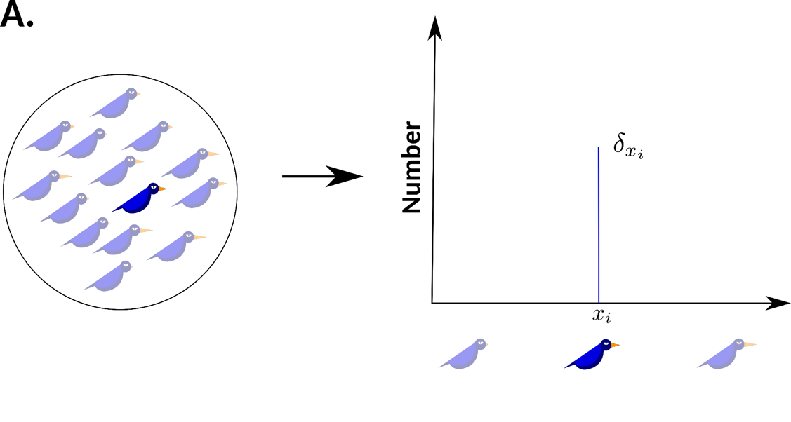
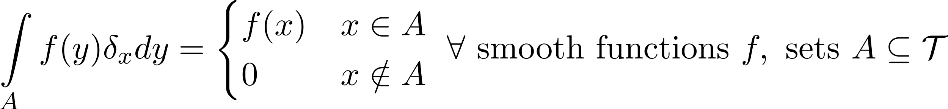
Individuals as ‘Dirac masses’

Slide 10
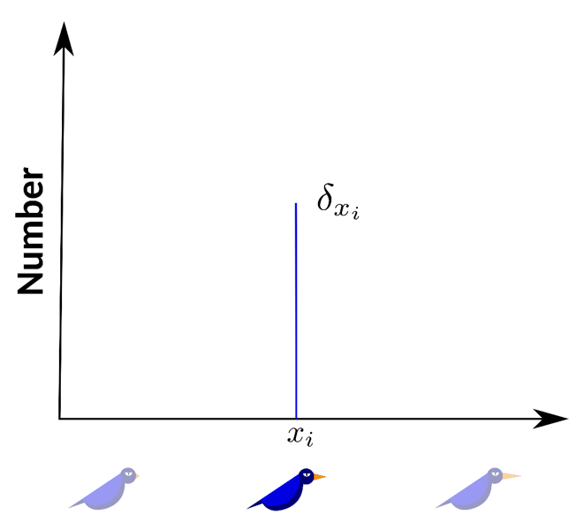
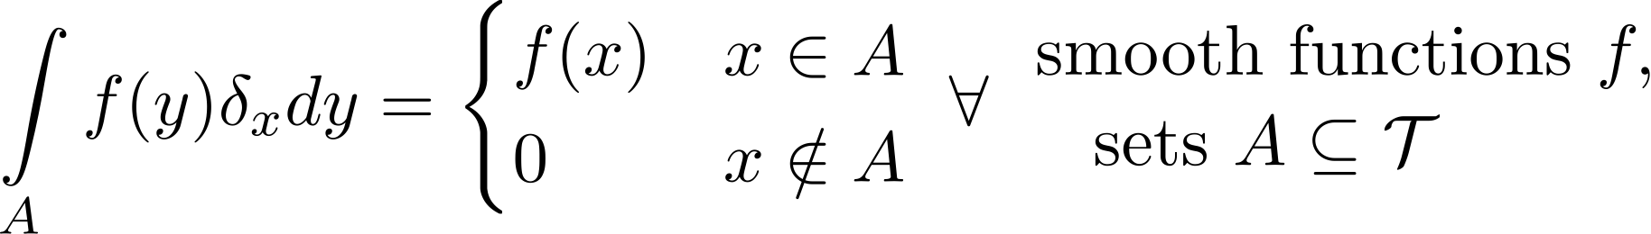
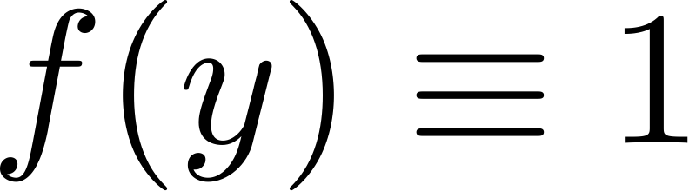
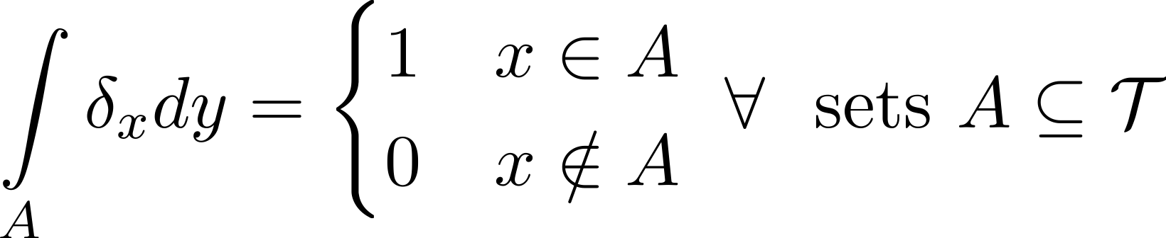
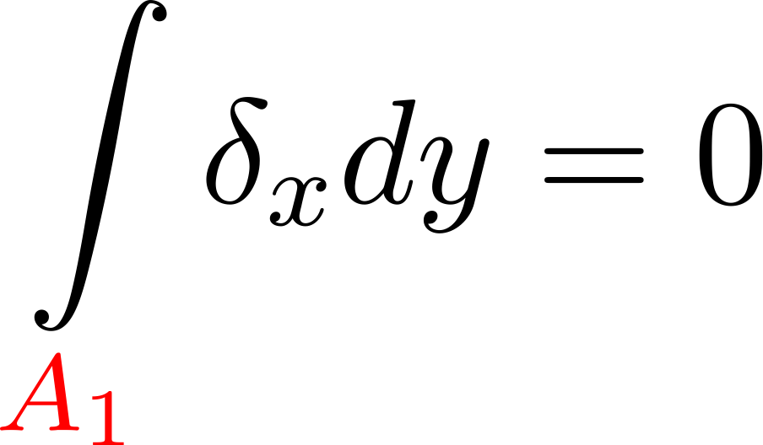
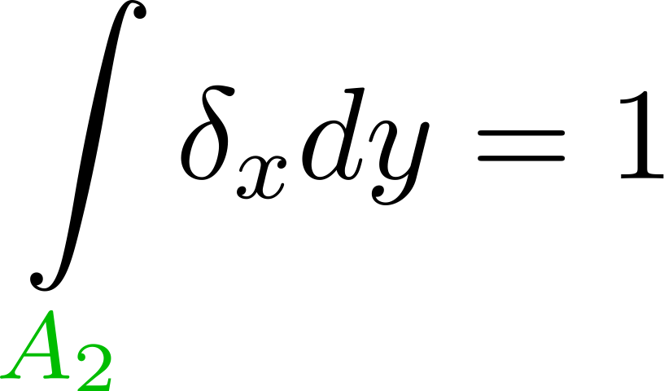
‘Dirac mass’ is just a fancy way to say ‘indicator’
A₁
A₂

Slide 11
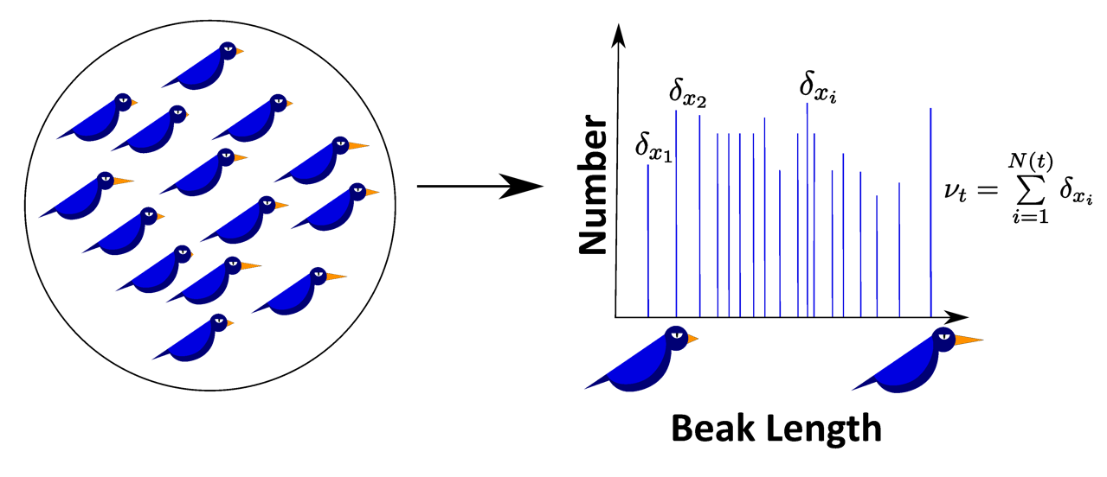
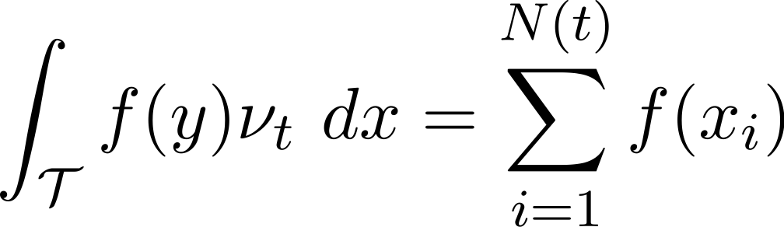
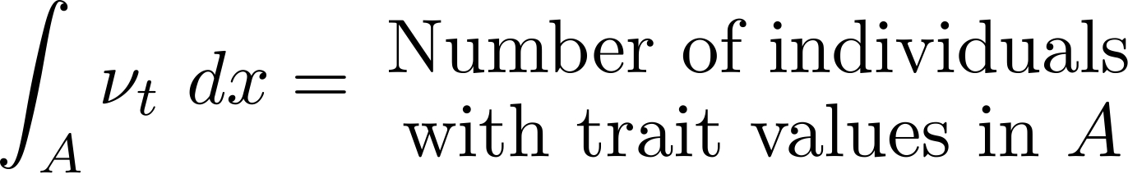
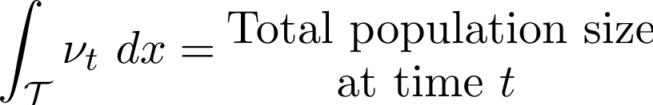
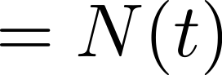
Populations as sums of Dirac masses

Slide 12
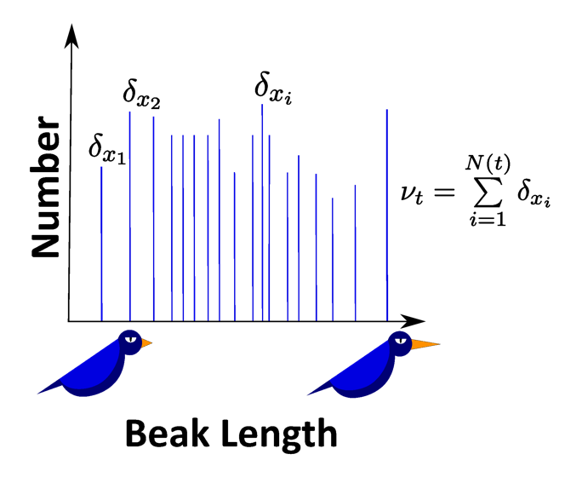
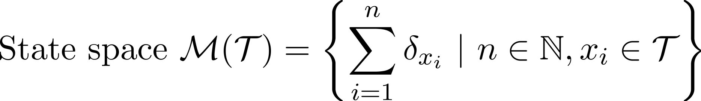
Population dynamics as a ‘function’-valued stochastic process

Slide 13
Population dynamics as a ‘function’-valued stochastic process

Slide 14
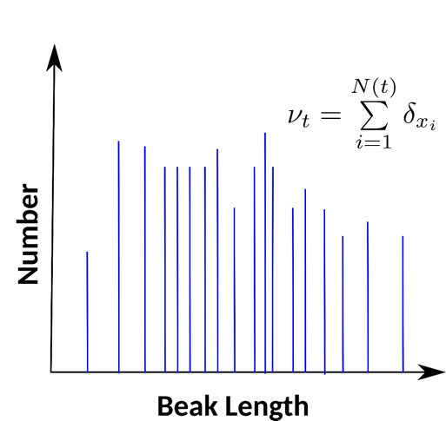
Describing our stochastic process

Slide 15
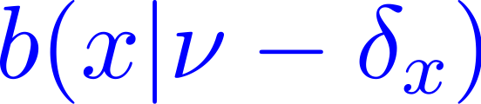
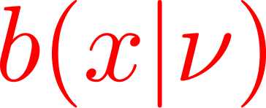
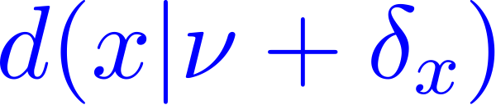
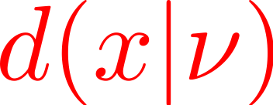
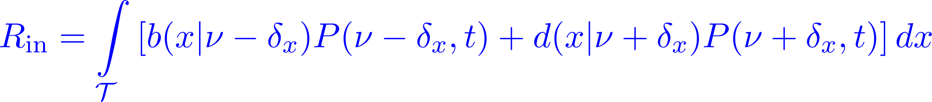
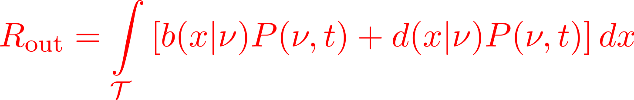
Describing our stochastic process: Counting transitions
Rate of ‘inflow’
Rate of ‘outflow’

Slide 16
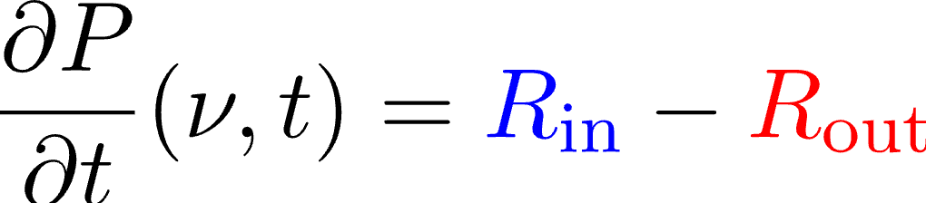
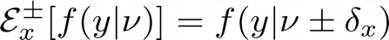
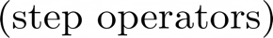
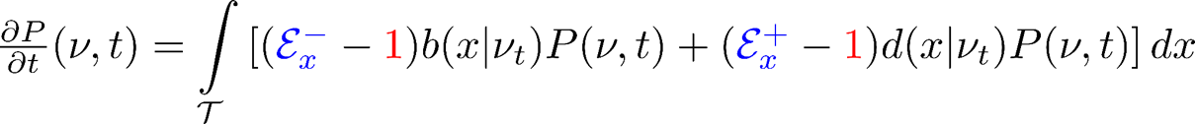
Describing our stochastic process: A functional master eqn

Slide 17
Idea: Approximate the population by a continuous function (“field”)
≈

Slide 18
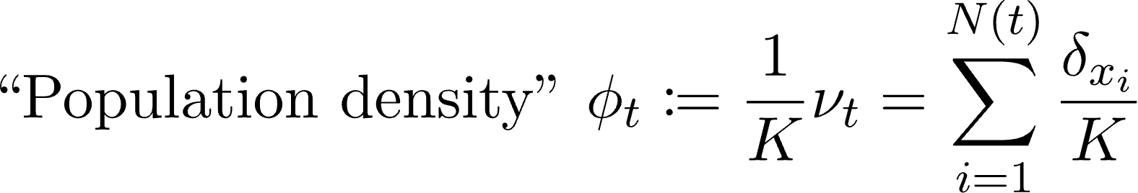
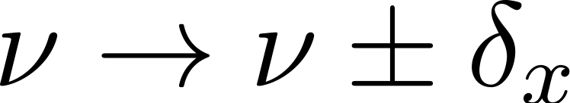
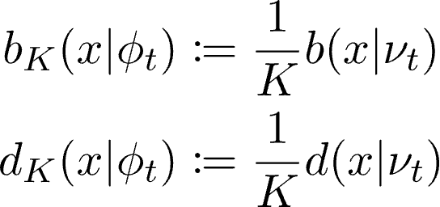
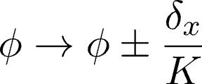
Idea: Assume system size parameter, Taylor expand

Slide 19
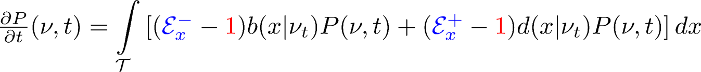
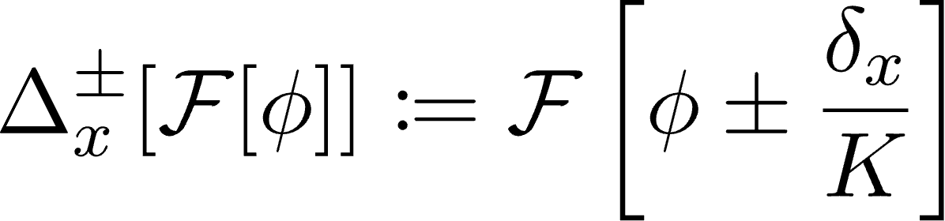
Rewriting the process in terms of population densities

Slide 20
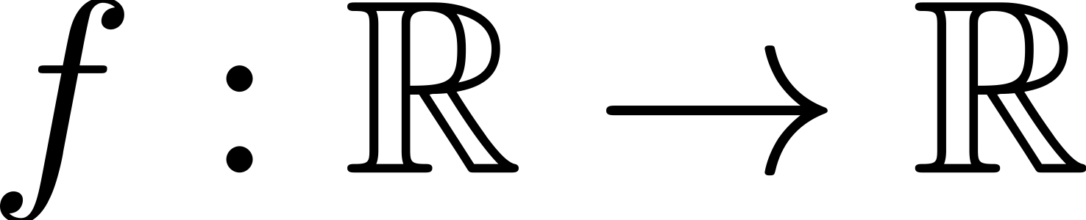
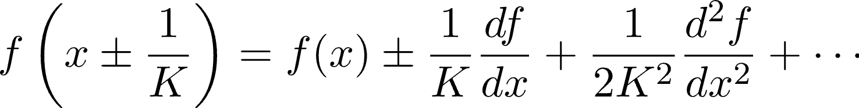

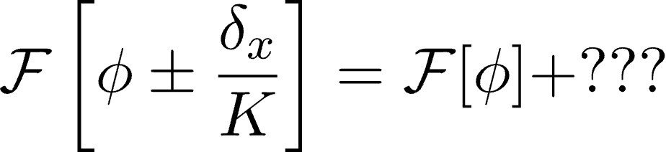
The problem: The ‘small perturbation’ is a function

Slide 21





Interlude: How do you differentiate wrt a function?

Slide 22


Interlude: Directional derivatives

Slide 23




Interlude: Directional derivatives

Slide 24



Interlude: Functional derivatives
c
c

Slide 25


Taylor expansions of functionals

Slide 26

Taylor expanding our functional Master Equation
Taylor expansion formula:
Definition of the Dirac mass:

Slide 27

Taylor expanding our functional Master Equation

Slide 28


A ‘functional’ Fokker-Planck equation
Fokker-Planck Equation (Kolmogorov forward equation):
Stochastic differential equation:
The stochastic partial differential equation (SPDE) description:

Slide 29






The ‘spacetime white noise’ Ẇ(x,t)
The purely temporal white noise η(t)

Slide 30



Some resultant equations for evolutionary biology
Replicator-Mutator equation ( = Crow-Kimura equation)
Price equation

Slide 31




Moving to Fourier space to recover discrete morphs
Rogers and McKane 2015

Slide 32



Consequences for population biology: ‘noise-induced biasing’
Change in mean phenotype
=
Effect of Selection (covariance with fitness)
+
Mutation/
Transmission bias
Change in mean phenotype
Effect of Selection (covariance with fitness)
Mutation/
Transmission
bias
New deterministic term
(‘direct’ mechanism)
=
+
+
+
New stochastic term
(‘indirect’ mechanism)

Slide 33





Stochastic extensions of some standard equations of population genetics
Frequencies
(Replicator eqn)
Means
(Price eqn)
Variances
(Heterozygosity
eqns)

Slide 34






Consequences for population biology: ‘noise-induced biasing’
vs

Slide 35


Open question: how do we incorporate multiple traits?
Champagnat et al 2008
Etheridge et al 2024

Slide 36




Open question: how do we incorporate multiple traits?
I’m not a physicist!!!

Slide 37






For Details:
abhat@uni-mainz.de
@shikharabhat.bsky.social
Personal Webpage

Slide 38






A consequence unique to quantitative traits
The strong selection, weak mutation limit:
Rare mutations (i.e. mutation rate is small)
Small mutational effects (i.e. mutants are very close to parents: `almost faithful' reproduction)
Strong selection: Types with low relative fitness are immediately eliminated and the population is sharply peaked around a few trait values.

Slide 39





Spacetime stochastic calculus via an infinite-dimensional Itô formula
Itô’s formula:

Slide 40




An example: Asexual resource competition model

Slide 41

An example: Asexual resource competition model
“Quantitative logistic equation” (with mutations)
Competition is only
within-phenotype
“Fisher-KPP equation”

Slide 42




The ‘system size’ parameter
K = 100
K = 1000
K = 10000

Slide 43





I live in Mainz (Germany) now
Personal Webpage
abhat@uni-mainz.de
@shikharabhat.bsky.social

